Slide 1

APPSERVICE

Slide 2
What is meant by App Service
Azure App Service enables you to build and host web applications in the programming language of your choice without managing infrastructure.
The most fundamental building block of Azure App Service is the App Service plan or App Service environment.
There are two types of hosting environments within App Service. App Service plan and App Service environment.
App Service Environment is a more sophisticated version of the App Service plan and comes with a lot more features when compared to the App Service plan.
Within these, we can host several Apps like - web applications, web jobs, batches, APIs, and mobile backend services that can be consumed from our mobile Front-End.

Slide 3
Benefits of App Services:
Fully managed environment
It's a fully managed environment, meaning App Service automatically patches and maintains the OS and language frameworks for you.
Multiple programming languages and frameworks are supported
Azure App Service supports a wide variety of programming languages and frameworks.
.NET
.NET Core
Java
Ruby
Node.js
PHP
Python
You can also run PowerShell and other scripts or executables as background services.

Slide 4
Scalability
Based on the demand for your application, App Service can scale resources up and down or in and out. You can do this either manually if you want to or automatically based on metrics like CPU utilization for example.
Security
Authenticate users with Azure Active Directory or any of the external authentication providers like Google, Facebook, Twitter, or Microsoft.
Compliance
App Service is ISO (International Organization for Standardization), SOC (Service Organization Controls), and PCI (Payment Card Industry) compliant.

Slide 5
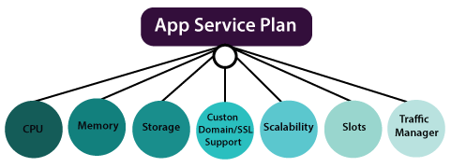
App Service Plan
An app service plan denotes a set of features and capacity that we can share across multiple apps in the same subscription and geographical region.
A single or dual app can be configured to run on the same computing resources.
Each App Service plan defines:
Region (West US, East US, etc.)
Number of VM instances
Size of VM instances (Small, Medium, Large)
Pricing tier

Slide 6
Environment Features
Development frameworks: App Service supports a variety of development frameworks, including ASP.NET, classic ASP, node.js, PHP, and Python- all of which run as extensions within IIS.
File access
Local drives - Operating system drive (D:\drive), an application drive and user drive (the C:\ drive)
Network drives - Each customer's subscription has a reserved directory structure on a specific UNC share within a datacenter.
Network access: The application code can use TCP/IP and UDP based protocols to make outbound network connections to access Internet endpoints that expose external services.

Slide 7
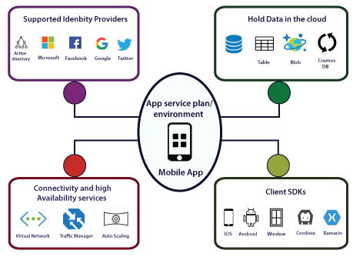
Azure Mobile App
We can deploy our mobile backend services on Azure using Azure Mobile apps.
By implementing our mobile backend service on Azure, our mobile backend will be able to communicate with different Azure services.
We can able to take advantage of various features that are provided by Azure Mobile Apps.

Slide 8
Features and services
Data Storage: Our mobile backend can be able to store the data or access the data of Azure SQL database Azure table storage, Azure Blob storage, and Cosmos DB. And also, we can add offline sync features to our mobile app.
Authentication and Authorization: We can integrate our mobile app with different authentication providers. So we can integrate with Azure active directory, Microsoft, Facebook, Google, and Twitter. We can integrate this service without any code.
Connectivity: In terms of connectivity to apps that are hosted in a virtual network. Our mobile app will be able to connect to a virtual network either using point to site VPN or by hosting our mobile app backend service into an app service environment, which will automatically get connected to the virtual network.

Slide 9
Azure App Service Backup
The App service backup and scaling is much simpler than virtual machine backup and scaling. The backup and restore in-app feature service let us quickly create app backups.
This backup of app service will contain app configuration also, the file content, and optionally the database connected to our app. We can take backup along with the app service.
The backup will be stored in a storage account. And in terms of restoration, we can restore an app with its linked database on-demand to its previous state, using the backup, or we can create all-together a new app using that app backup.

Slide 10
Different Types Of App Services:
The following are the 4 main types of app services .
They are:
Web Apps
API Apps
Logic Apps
Function Apps

Slide 11
Web App:
used for hosting websites and web applications (previously Azure Websites)
API App:
used for hosting the RESTful APIs
Logic App:
used for business process automation, system integration and sharing data across clouds.

Slide 12
Difference Between App Service and Web App:
A Web App is a web application that is hosted in an App Service.
The App Service is the managed service in Azure that enables you to deploy a web application and make it available to your customers on the Internet in a very short amount of time.
Web apps need an active internet connection in order to run, whereas mobile apps may work offline.
Mobile apps have the advantage of being faster and more efficient, but they do require the user to regularly download updates. Web apps will update themselves.

Slide 13
APP Service Overview:
Azure App Service is a fully managed platform as a service (PaaS) offering for developers.
Here are some key features of App Service:
Multiple languages and frameworks
Managed production environment
Containerization and Docker
API and mobile features
Serverless code

